Slide 1
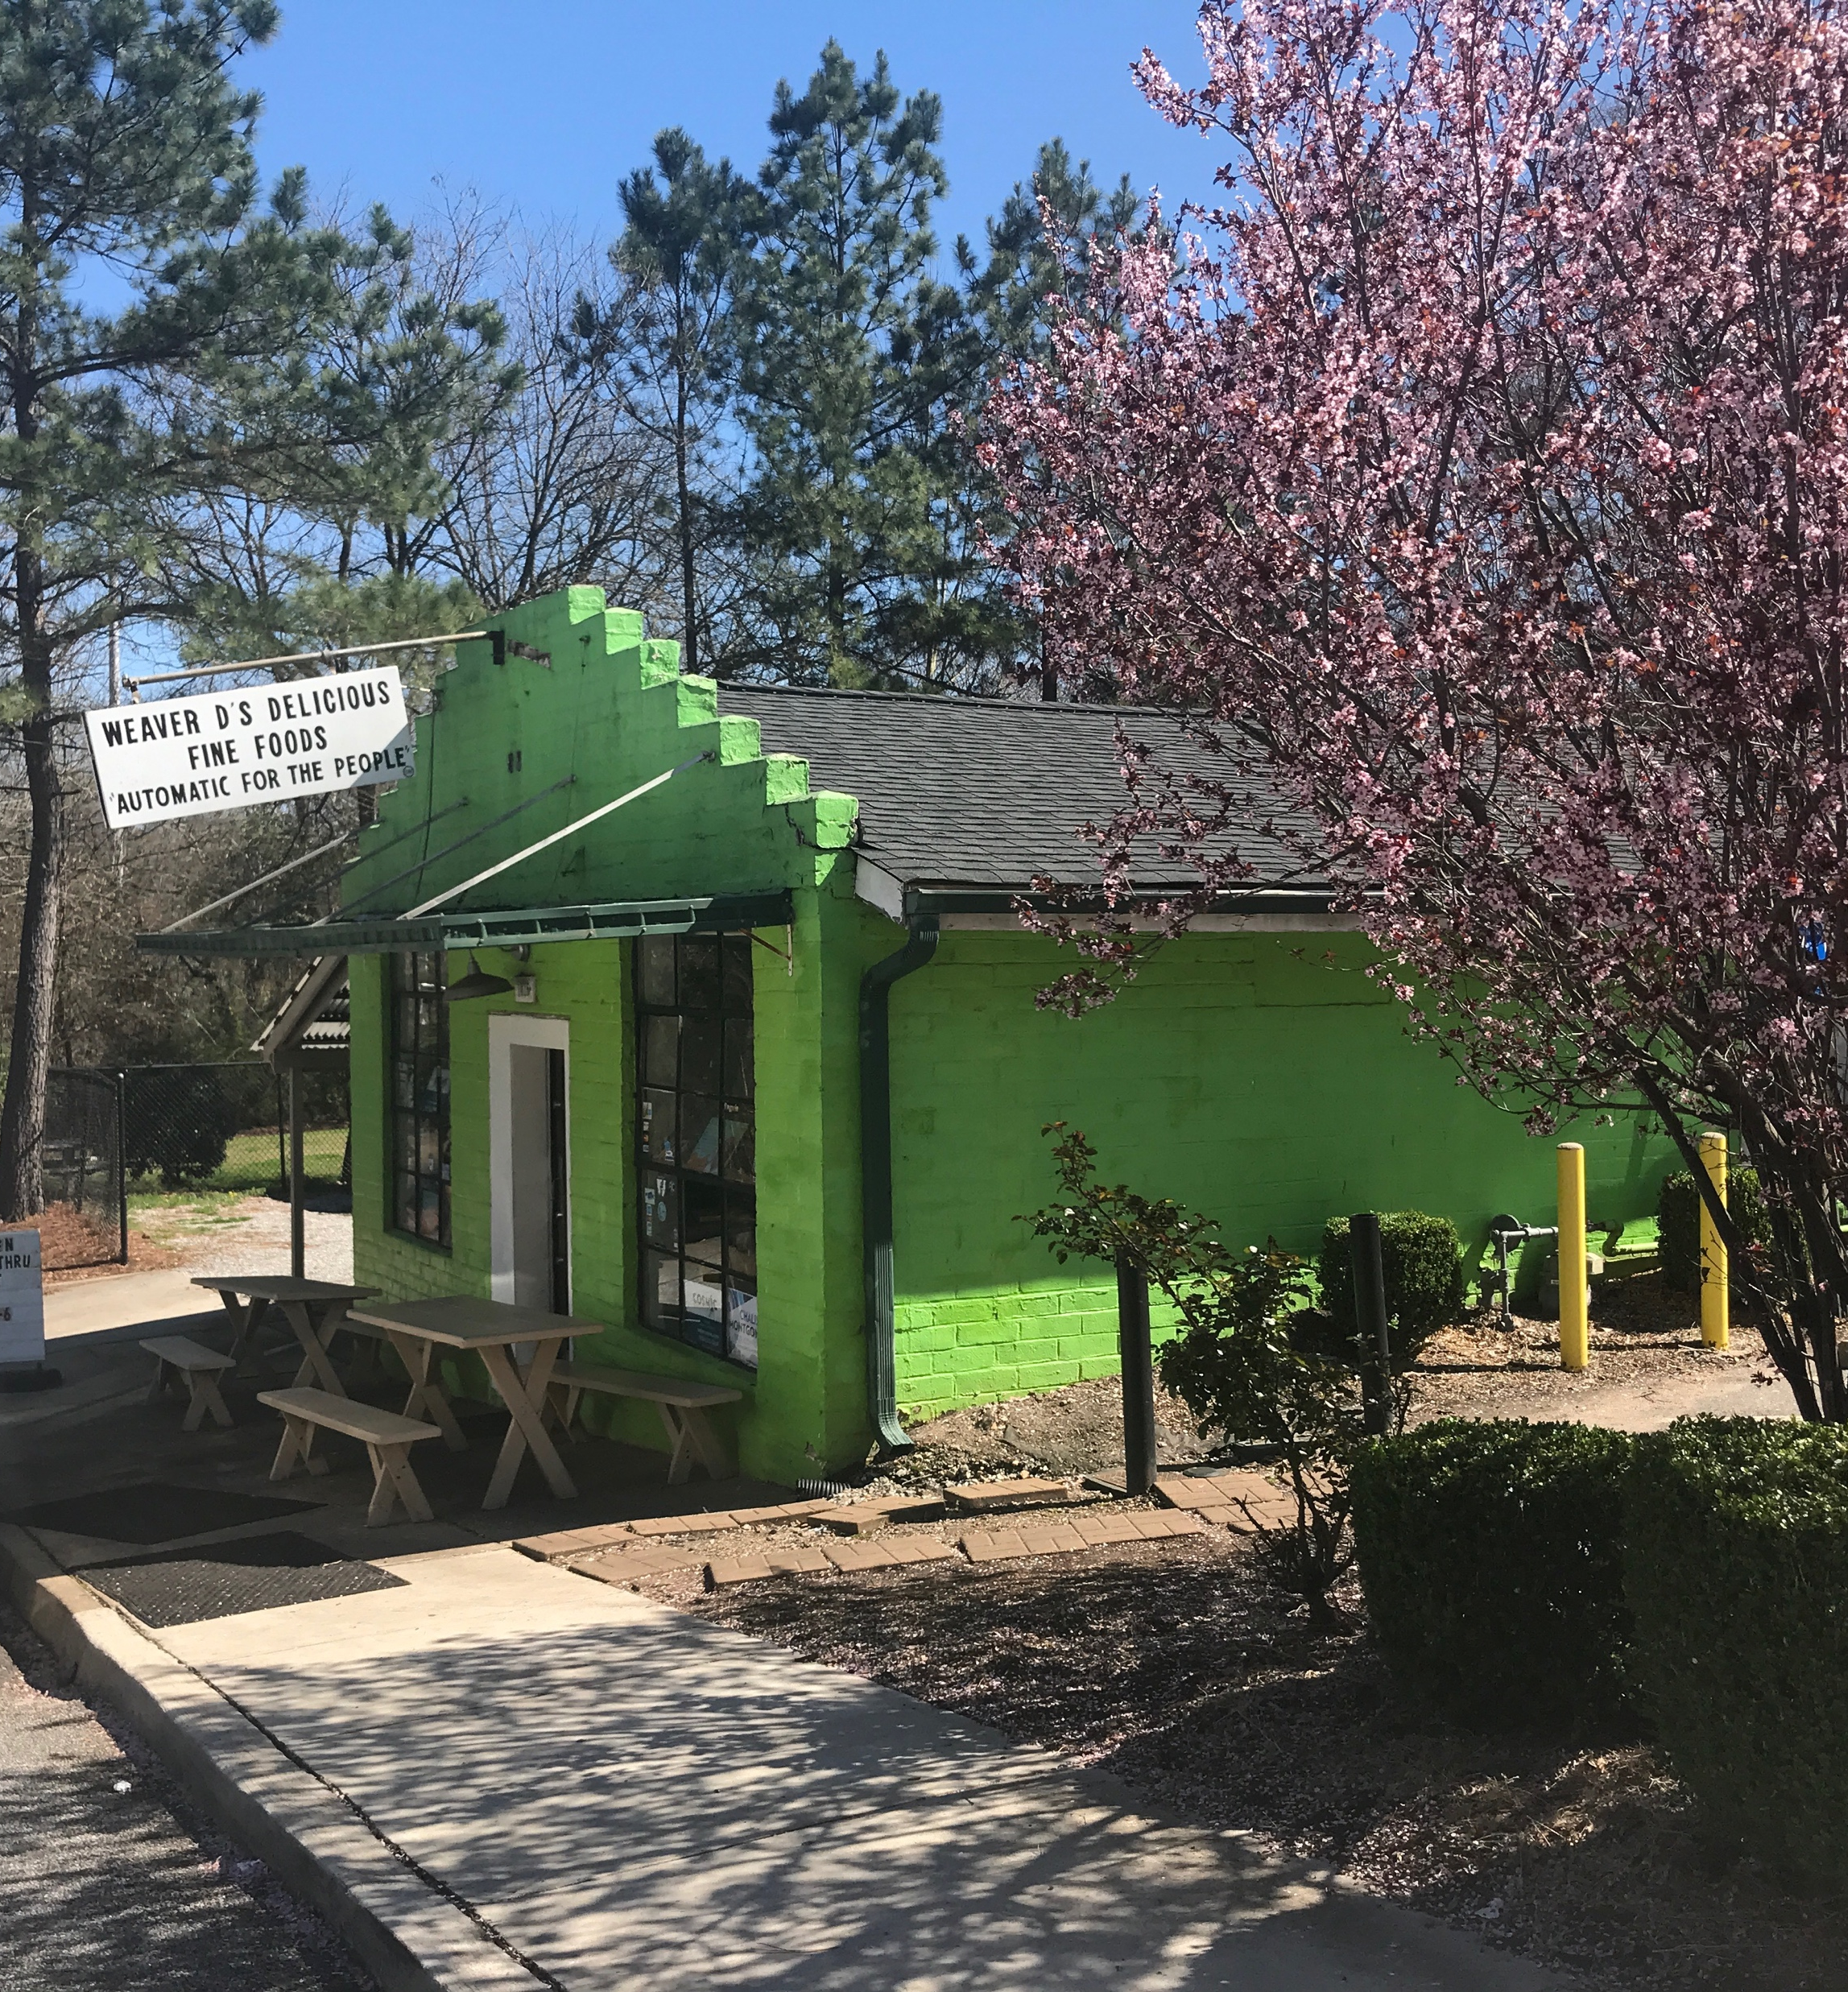
The most powerful tool we have as developers is automation.
- Scott Hanselman
Photo: Grady News Source. UGA

Slide 2
Sounds great – but what if our computers are different?
?

Slide 3
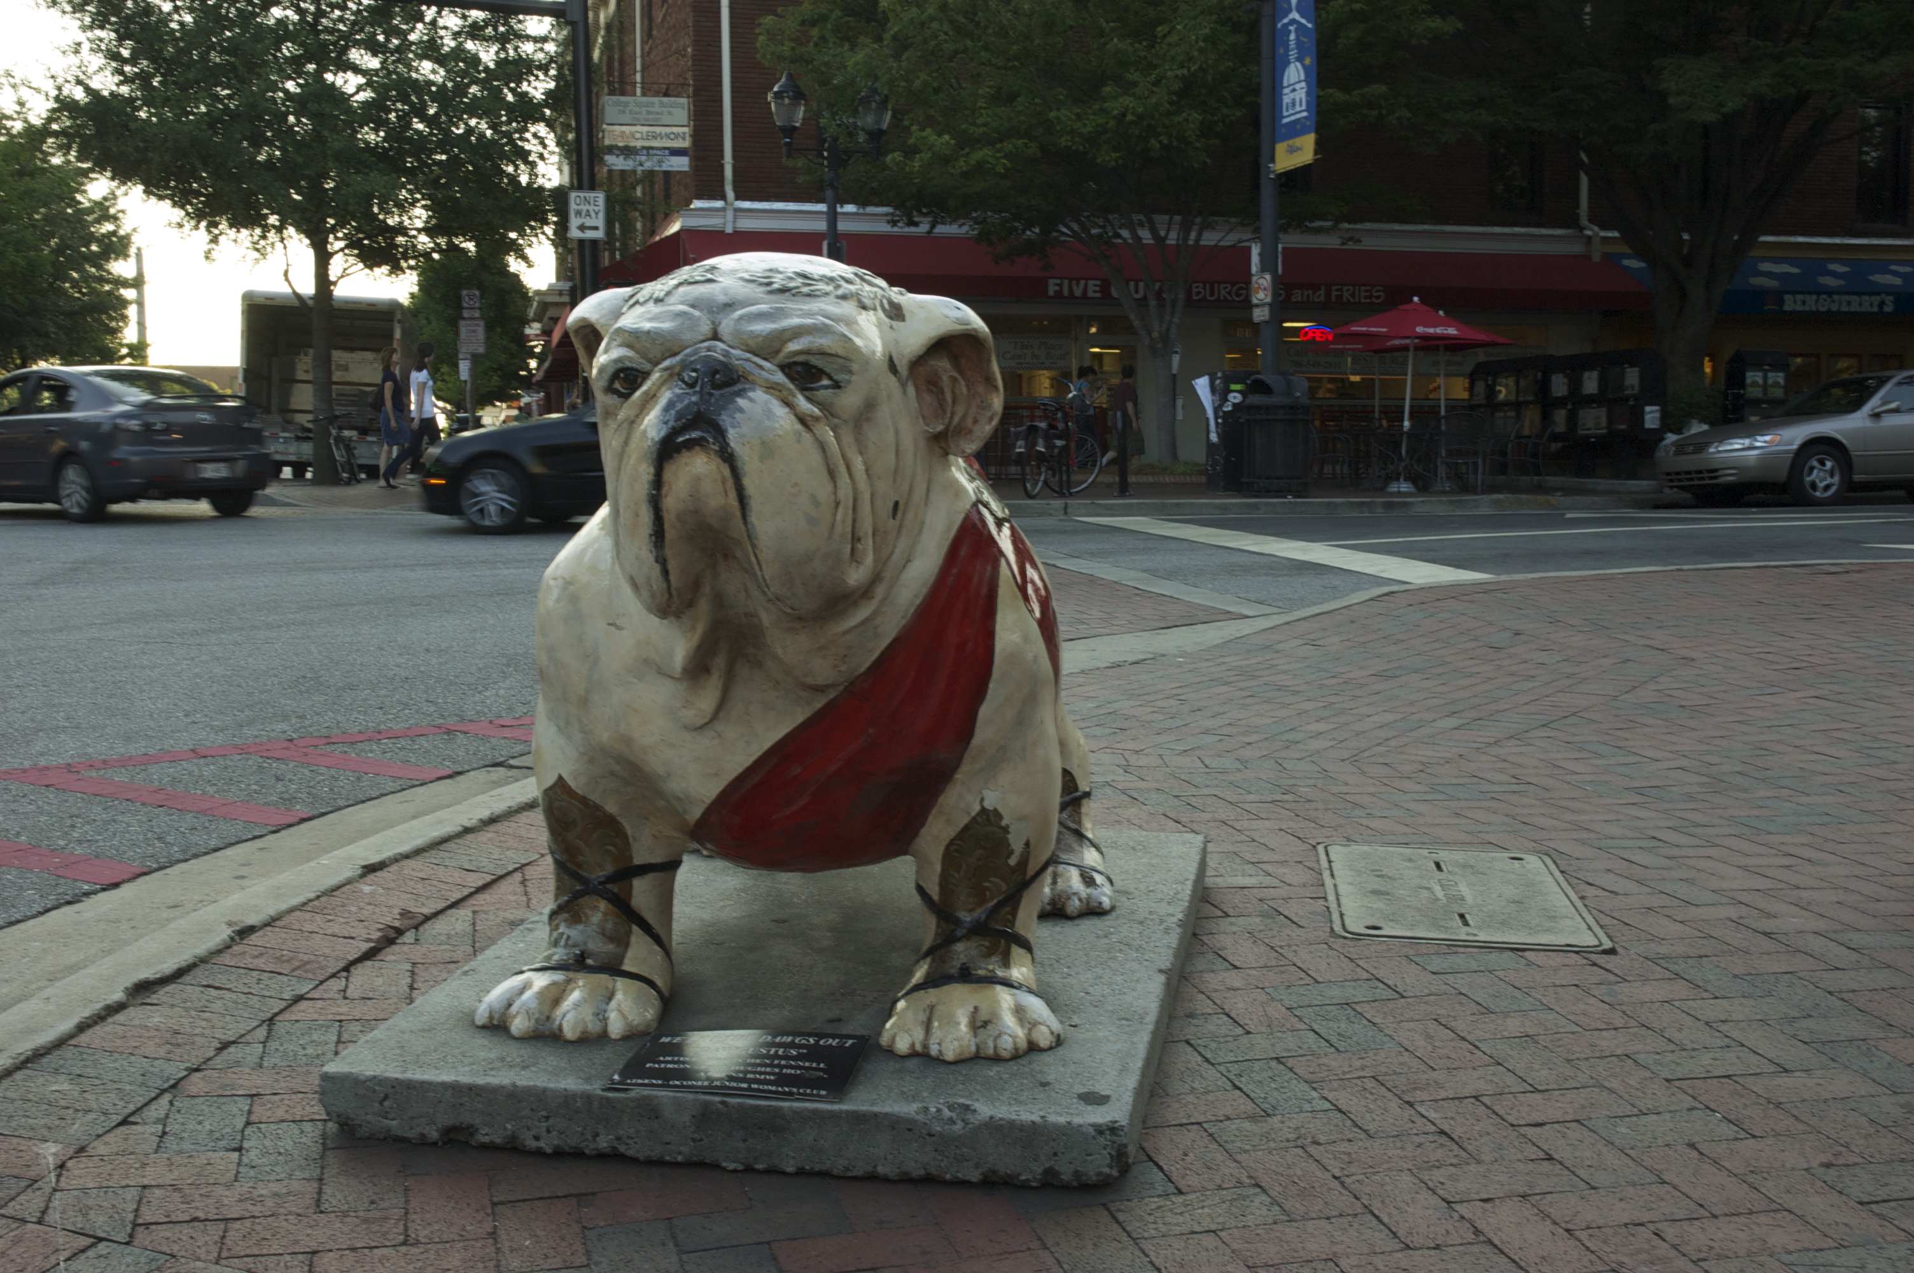
Photo: Kevin Christopher Burke (Flickr CC)

Slide 4

Photo: Erik Kilby (Flickr CC)

Slide 5
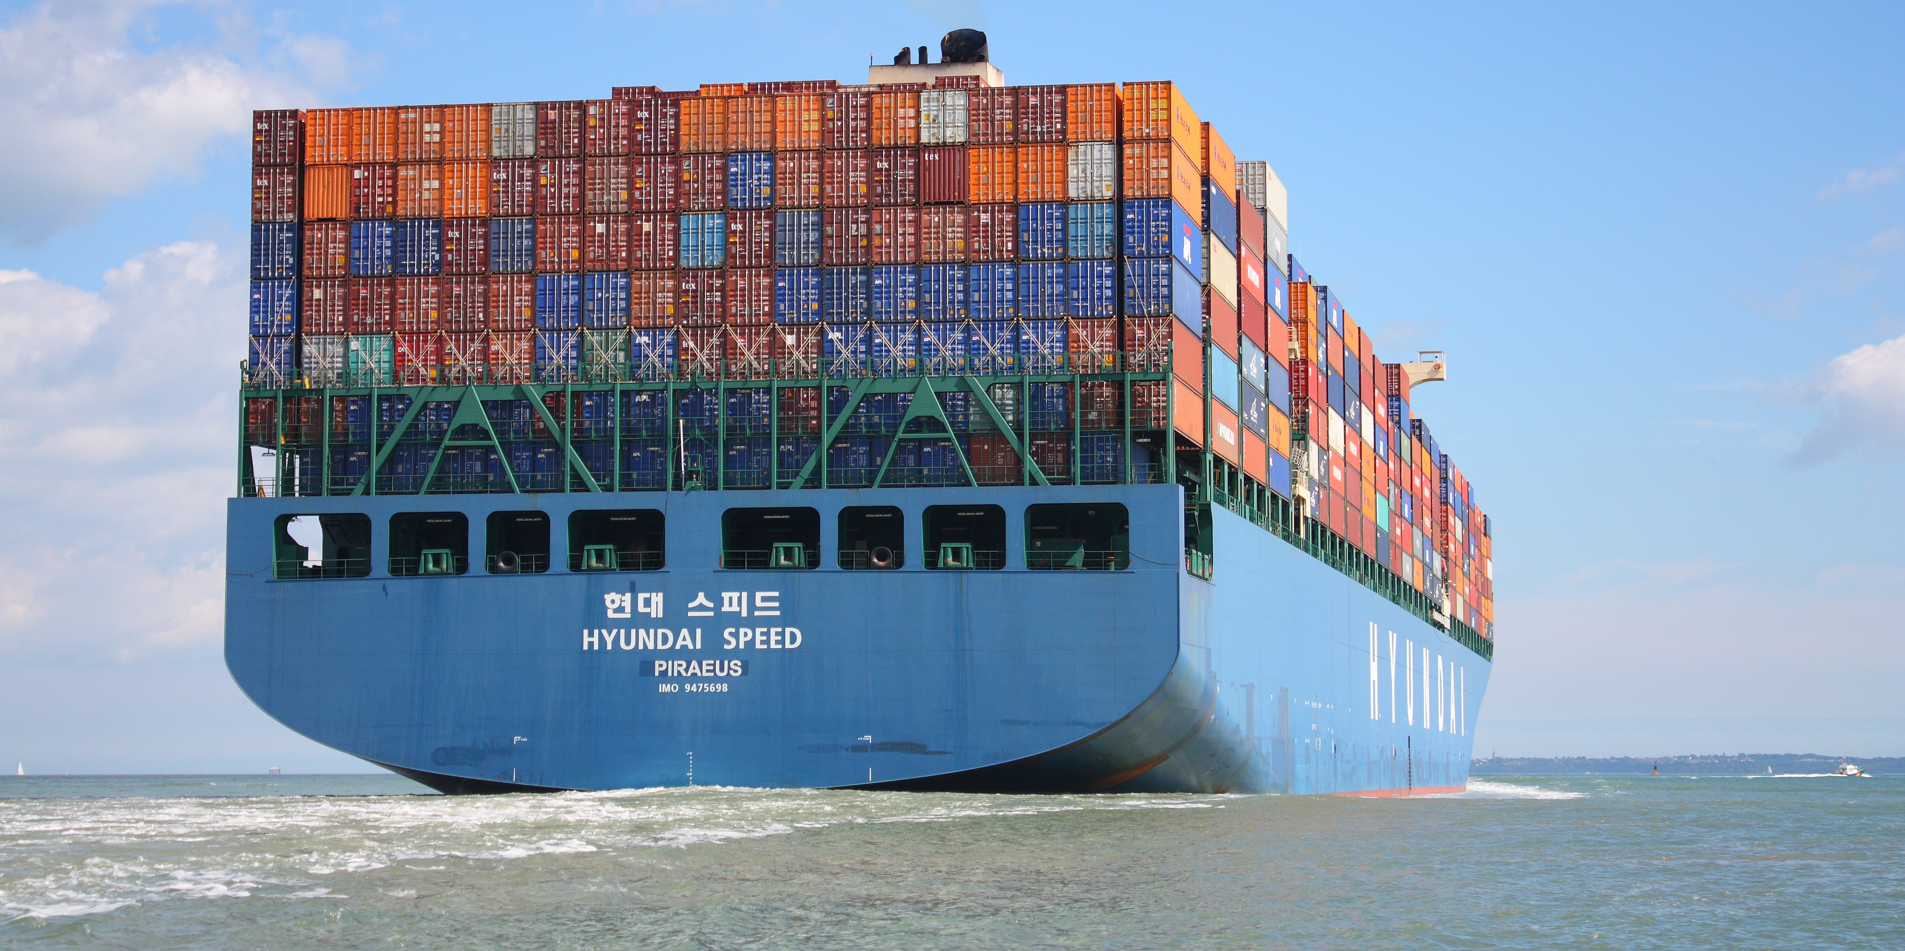
How do we ship different objects on the same vessels?
Photo: LiteMeterPix (Flickr CC)

Slide 6

Docker: shipping containers for software.

